Slide 1

Movie Recommender System
Sanjay Jaras
Bellevue University

Slide 2

Introduction and Problem Statement
The volume of content increasing on entertainment/media platforms.
The number of choices available is increasing rapidly on e-commerce sites.
Recommender system sorts a large list of products/contents as per user’s taste/earlier choices.
Without recommendations users might get lost in the volume of content availability.
Good recommendations keep a user engaged for the long term.
Good recommendations attract users to products/contents of his/her choice.

Slide 3
Types of Recommender System
Content-Based Recommender System
Collaborative filtering-based Recommender System
Popularity-Based Recommender System
Hybrid Recommender System

Slide 4
Major Steps
Data understanding
Data cleaning and preparation
Simple model using Weighted Ratings
Content-Based Model
Hybrid model: weighted ratings + content-based model
Collaborative filtering-based model
Hybrid model: Content-Based + Weighted Rating + Collaborative Filtering

Slide 5
Dataset
Movie rating dataset taken from grouplens.org
Ratings dataset contains 25 million movie ratings given by 162K users for 62K movies
The movie metadata dataset taken from Kaggle.com.
The metadata dataset contains metadata about 45K movies.

Slide 6
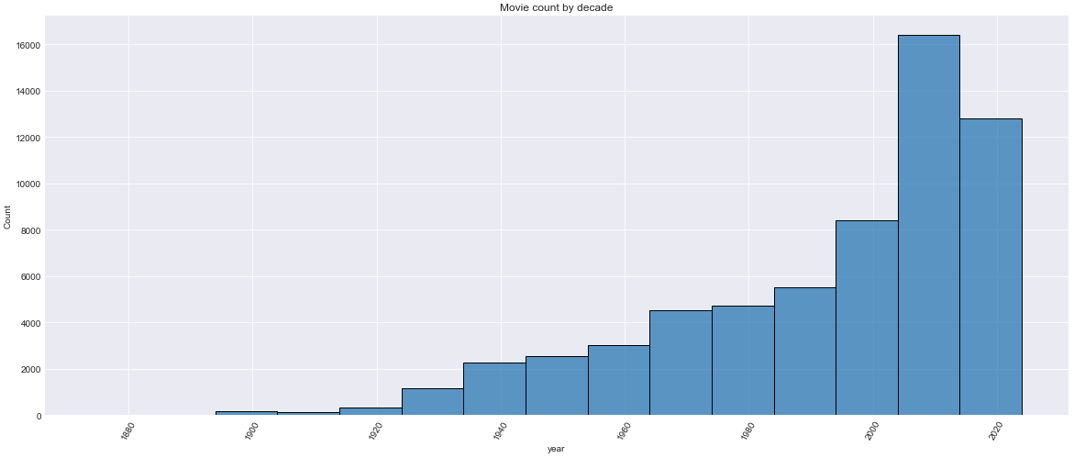
Exploratory Data Analysis
Movies dataset contains movies from 1885-2020

Slide 7
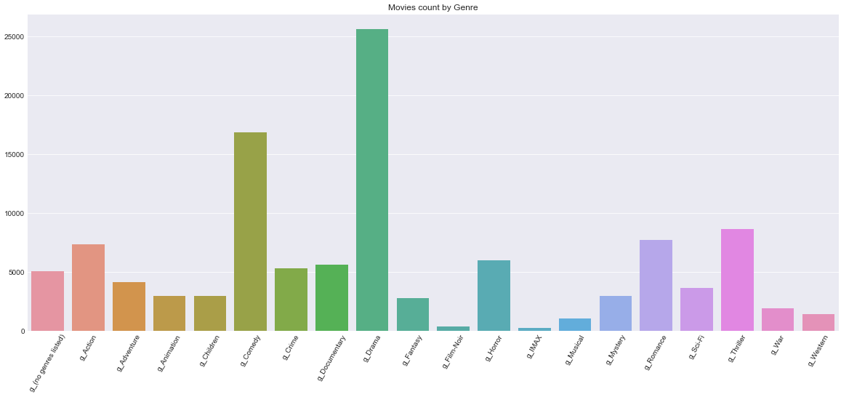
Exploratory Data Analysis
Movies are from different genres

Slide 8
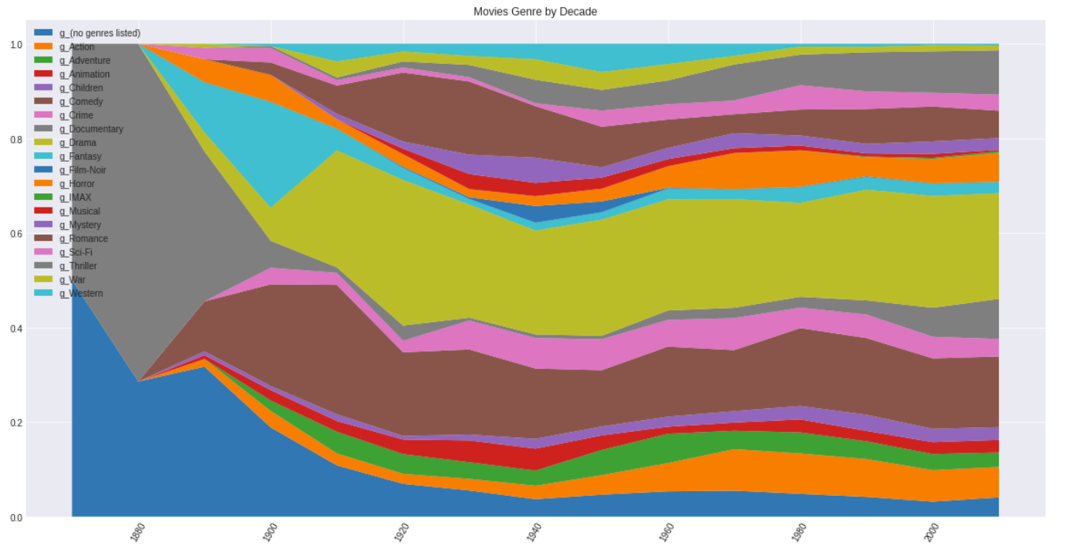
Exploratory Data Analysis
Drama and Romance movies are major part through movie history

Slide 9
Data cleaning and preparation
Ratings column converted to int8
Converted “movieId” column from ratings dataset and “id” column from metadata dataset to int for linking
Create year column from release date
Filled null values with empty strings

Slide 10
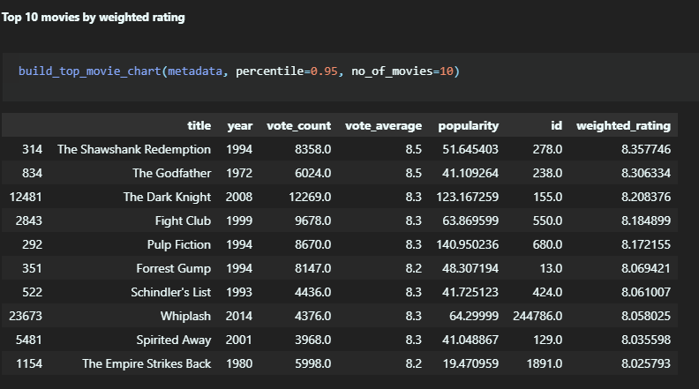

Weighted-Rating based recommender
Problem with Rating based model
v is the number of rating for the movie
m is the minimum number of rating required to be listed in the chart
R is the average rating of the movie
C is the mean rating across the whole report

Slide 11
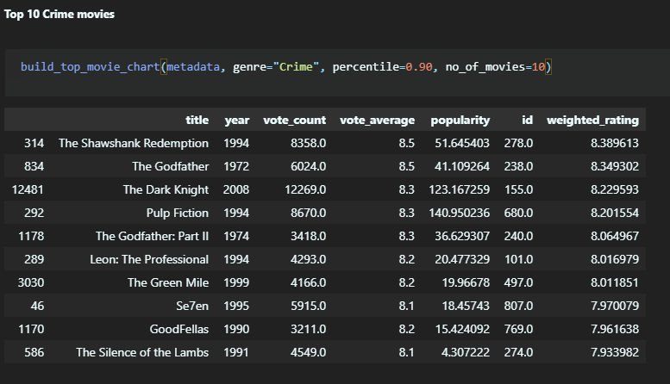
Weighted-Rating based recommender

Slide 12
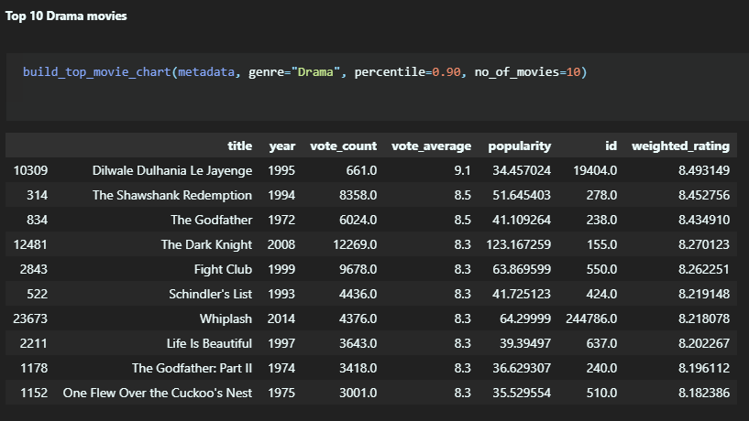
Weighted-Rating based recommender

Slide 13
Content-based recommender
Problem with weighted-rating based recommender
Features considered:
genres
spoken_languages
Tagline
Overview
Used matrix of TF-IDF features using n-gram range of 1-2
Calculated cosine similarity score using linear kernel

Slide 14
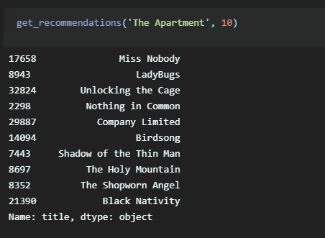
Content-based recommender
Recommendations using content-based recommender for movie “The Apartment”

Slide 15
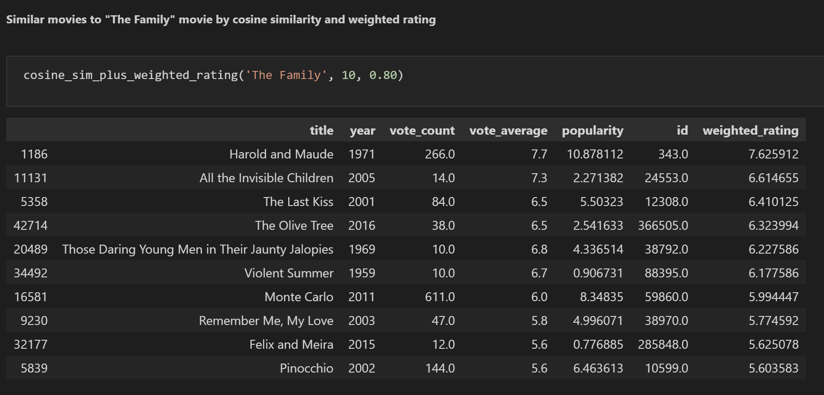
Hybrid recommender Content-based + Weighted rating based

Slide 16
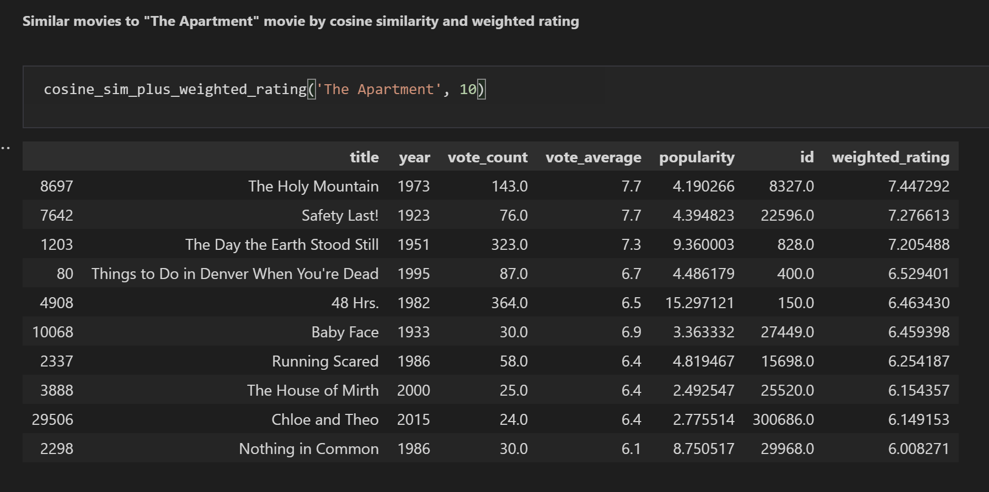
Hybrid recommender Content-based + Weighted rating based

Slide 17
Collaborative filtering-based recommendations
Rating based
Predict estimated rating for a movie using already given ratings by users
Used Surprise Library: SurPRISE - Simple Python RecommendatIon System Engine
Used Grid Search to compare and hyperparameter tuning
Compared SVD and KNN

Slide 18
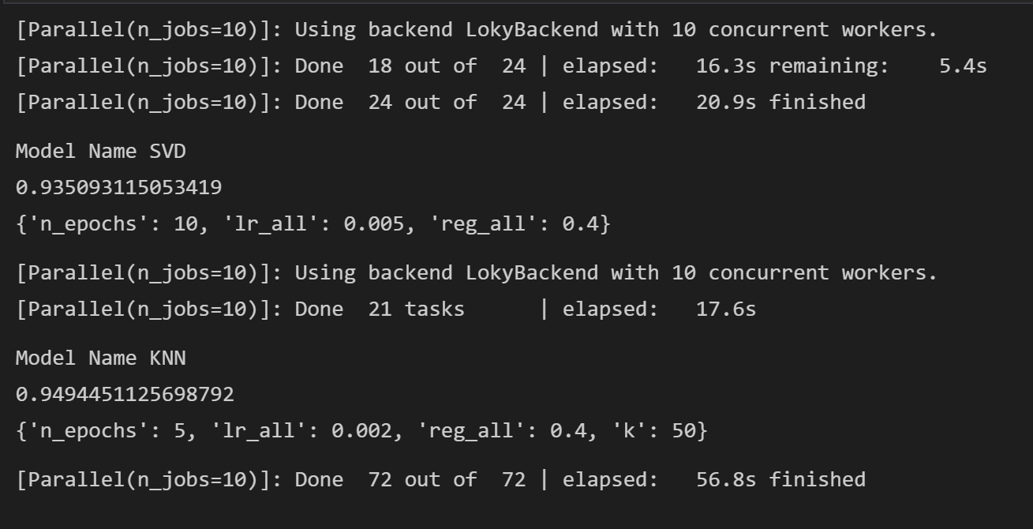
Collaborative filtering-based recommendations
Grid Search Results
Selected SVD due to hardware limitations

Slide 19
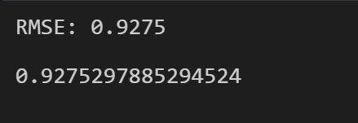
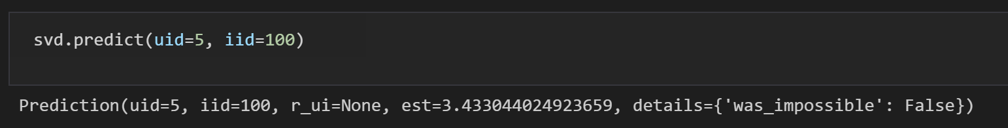
Collaborative filtering-based recommendations
Performance of SVD on Test dataset (25%)
Accuracy on test dataset
Prediction for user id 5 and movie-id 100

Slide 20
Hybrid Recommendation: Content-Based + Weighted Rating + Collaborative Filtering
Find similar movies using content-based recommendations
Apply weighted rating filter based on parameter
Predict estimating rating for each movie
Sort based on ratings and return top results

Slide 21
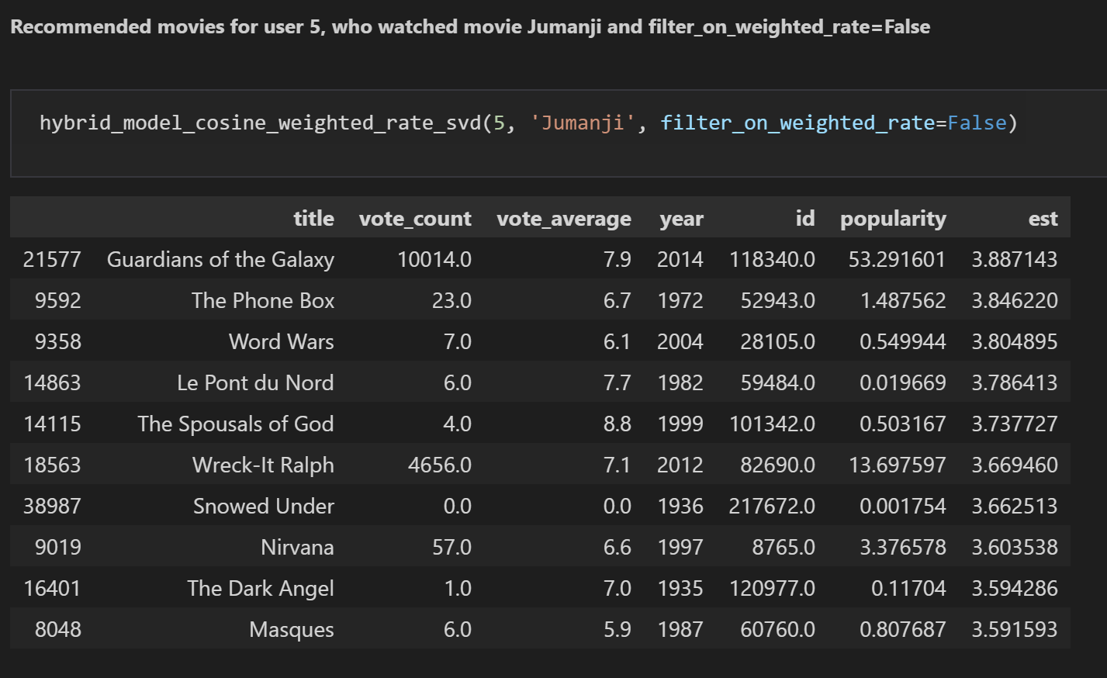
Hybrid Recommendation: Content-Based + Weighted Rating + Collaborative Filtering

Slide 22
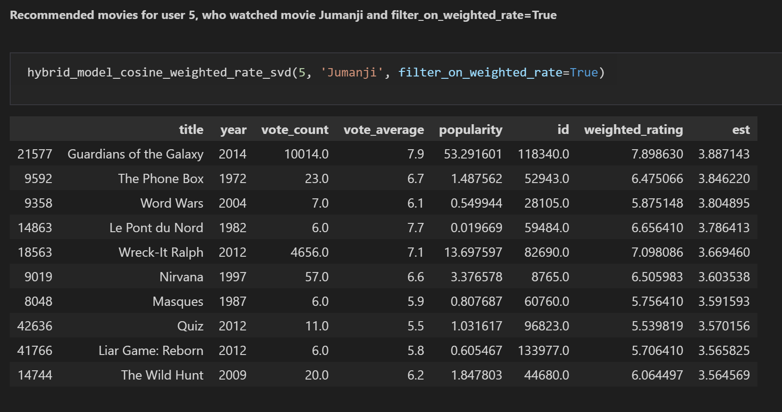
Hybrid Recommendation: Content-Based + Weighted Rating + Collaborative Filtering

Slide 23
Thank You!

